Slide 1
Graph Coloring for Efficient Code Compilation
Andrew Erickson, Ethan Rapa, Haven Cook
CSCI | 12/04/2025

Slide 2
Background to Register Allocation
Output assembly of compiled C code can vary heavily while retaining function
Often targets programmer’s intent
Many ways a compiler can optimize code for specific hardware and software
In this case, register allocation (graph coloring problem)
Each color corresponds to a machine register
Goal: assign registers without conflict
If registers are limited → spilling to memory occur
Better coloring -> more efficient compiled code
Notes:
“When we compile C code, the final assembly can look very different even if the program behaves the same. That’s because the compiler is free to optimize aggressively based on its understanding of the programmer’s intent.”
• “A huge part of this optimization space comes from targeting specific hardware and microarchitectural constraints—things like pipeline behavior, register files, or calling conventions.”
• “One of the most important steps in this pipeline is register allocation, which we can frame as a graph-coloring problem: each variable is a node, and edges represent interference.”
• “A color corresponds to a physical machine register. So the goal is to assign colors in a way that no interfering variables get the same register.”
• “Because registers are limited, a poor coloring forces the compiler to spill variables to memory, which is extremely expensive.”
• “A better coloring—fewer spills, fewer memory spills—directly translates to more efficient compiled code.”

Slide 3
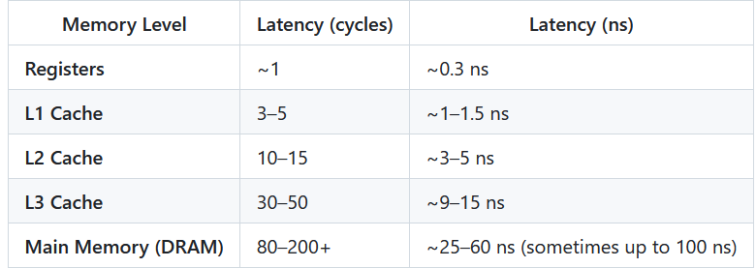
Background to Register Allocation
Notes:
This chart shows off the costs of spilling variables into lower and lower memories. As you can see if we want the program to execute quickly then we want as many memory access to come from the registers as possible and preferably we’d have no accesses from DRAM

Slide 4
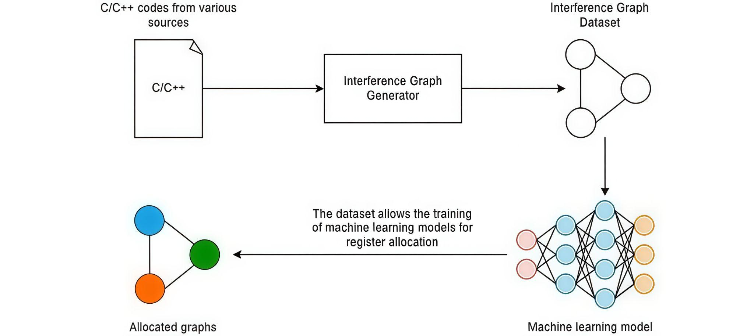
Next Steps: Interference Graph
Notes:
Via our literature review, we explored what was currently out there, allowing us to focus in on techniques that work. Above is a generalized workflow for deep graph coloring for register allocation.
The first step is collecting a wide range of code structures that would allow us to diversify & generalize generated interference graphs, so a model may learn features surrounding various types of interference
ANIMATE
The second step involves developing an interference graph generator, which is an LLVM-based approach. An intermediate representation (IR) of the c code is generated, which is an intermediate between source and target languages used by compilers for low-level processing and optimization. This language is perfect for extracting interference information and live states of variables. With this, an interference graph can be produced. The ultimate goal would be curating a large dataset of of interference graphs such that a training pipeline for a graph coloring model can be initialized.
We present in this project the means for developing this dataset via our automated graph generator workflow (Unfortunately we did not get to deep coloring in time)
We are excited to say this is one of the only complete open source models for developing an interference graph dataset from provided example code.
LLVM supports C, C++, and even interpreted languages such as Python, Ruby, Swift, etc through just-in-time compiling, so the potential for expanding this project past C is great
Ultimately, we hypothesize that there are embedded features in interference graphs generated by code that external generators cannot reproduce, which is commonly used when training coloring models.

Slide 5
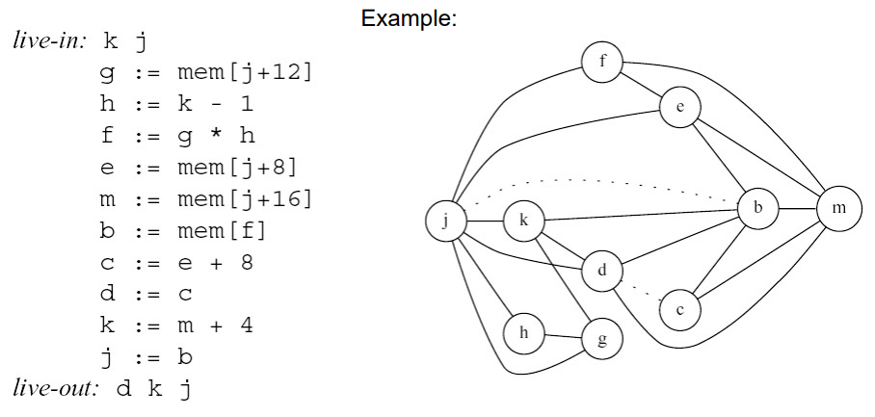
Next Steps: Interference Graph
Notes:
As a recap on what the interference graph describes: Neighboring nodes must remain in the active set and therefore must be placed on separate registers (colors)
Ex. j is active the entire time and will likely need a dedicated register
It is important to notice the “live-in” and “live-out” parts, which will be important when implementing branches or other non-sequential breaks that require an understanding of liveness before an after a sequence of instructions.
Previous authors of open source interference graph generators did not take per-block liveness into account, and only considered begin/end declarations

Slide 6
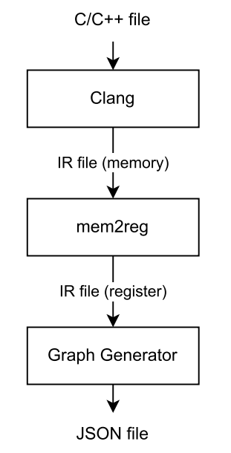
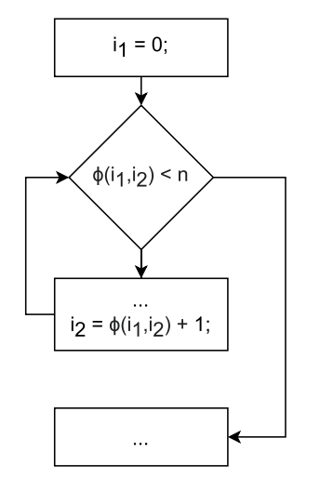
Interference Graph Construction
LLVM generates an IR file
Uses static single assignment (SSA).
Virtual registers assigned only once
Registers that overlap receive an edge
φ-Nodes collect additional information about spill cost
Indicate what can share registers in loops
Notes:
Using LLVM allows us to generate our own interference graph dataset. LLVM generates readable intermediate representation files while using static single assignment (generates virtual memory assignments which cannot be reassigned).
Mem2reg assists this by converting memory references to register references
This simplifies what instructions are overlapping when, and these virtual registers are the nodes in our graph. Any registers that are live in the same instruction receive an edge
Therefore we can use this knowledge to generate interference graphs from instruction datasets.
This definitely over-simplifies, and complexities are added with multi-function sets, branching, non-sequential instructions, and branch dependencies
Specifically, when dealing with phi nodes, often times a loop, they help resolve the issue where virtual registers are only defined once. If a variable has multiple possible incoming values, this must be resolved at compile time. The phi node executes at run time, but it is resolved statically by control flow through assigning the value given what successor you visited

Slide 7

Example Compilation
define dso_local i32 @sum(ptr noundef %0, i32 noundef %1) #0 {
br label %3
3: ; preds = %10, %2
%.01 = phi i32 [ 0, %2 ], [ %9, %10 ]
%.0 = phi i32 [ 0, %2 ], [ %11, %10 ]
%4 = icmp slt i32 %.0, %1
br i1 %4, label %5, label %12
5: ; preds = %3
%6 = sext i32 %.0 to i64
%7 = getelementptr inbounds i32, ptr %0, i64 %6
%8 = load i32, ptr %7, align 4
%9 = add nsw i32 %.01, %8
br label %10
10: ; preds = %5
%11 = add nsw i32 %.0, 1
br label %3, !llvm.loop !6
12: ; preds = %3
ret i32 %.01
}
int sum(int *data, int len)
{
int s = 0;
for (int i = 0; i < len; ++i) {
s += data[i];
}
return s;
}
Notes:
To look at what LLVM generates, here is an example of a simple sum function being compiled first with LLVM and then the mem2reg optimizer. The function begins at the define keyword.
There is a lot ot pull from this file which I’ll go over in the next slide, but this is the general outline of a single function: begins with keyword define with an immediate branch “br”

Slide 8
Example Compilation
Block:
Container for sequential instructions
Denoted by block labels {label}:
Virtual Register:
Divides work via an abstracted infinite set of registers
Only assigned once
Branches:
PC jumps to a new address conditionally or unconditionally (Non Sequential divisions)
Phi Nodes:
Loops, conditionals depending on the previous block , etc.
define dso_local i32 @sum(ptr noundef %0, i32 noundef %1) #0 {
br label %3
3: ; preds = %10, %2
%.01 = phi i32 [ 0, %2 ], [ %9, %10 ]
%.0 = phi i32 [ 0, %2 ], [ %11, %10 ]
%4 = icmp slt i32 %.0, %1
br i1 %4, label %5, label %12
5: ; preds = %3
%6 = sext i32 %.0 to i64
%7 = getelementptr inbounds i32, ptr %0, i64 %6
%8 = load i32, ptr %7, align 4
%9 = add nsw i32 %.01, %8
br label %10
10: ; preds = %5
%11 = add nsw i32 %.0, 1
br label %3, !llvm.loop !6
12: ; preds = %3
ret i32 %.01
}
Notes:
A basic block is the compiler’s fundamental unit of sequential execution. Everything inside a block runs in order, with no jumps into or out of the middle.
Blocks are identified by a label — here we see %3, %5, and %10. Each block ends in a terminator, usually a branch, which hands control to the next block.
So anytime control flow can diverge, reconverge, or loop, LLVM breaks the program into different labeled blocks.////////
A virtual register has two defining properties:
There is an infinite supply, so LLVM never reuses register names.
Each register is assigned exactly once.
By coloring, the register allocator maps these virtual registers onto real machine registers. /////
Point out conditional vs unconditional branch
Conditional branches introduce non-sequential control flow, where liveness becomes a tree, with nodes being sequential operations
A phi node is an instruction used to select a value depending on the predecessor of the current block
Example:
void m(bool r, bool y){ bool l = y || r ; }

Slide 9
Per-block Liveness
N : Set of nodes of CFG;
for each n ∈ N do
in[n] ← φ;
out[n] ← φ;
end
repeat
for each n ∈ Nodes do
// First save the current value for IN and OUT for comparison later.
in'[n] ← in[n];
out'[n] ← out[n];
// For OUT, find out the union of previous variables
in the IN set for each succeeding node of n.
out[n] ← ∪s∈succ[n]in[s] ; // Compute OUT for a node.
in[n] ← use[n]∪(out[n]−def [n]); // Compute IN for a node.
end
// Iterate, until IN and OUT set are constants for last two consecutive iterations.
until ∀n,in'[n] = in[n] ∧ out' [n] = out[n];
Notes:
Here is where we begin tracing liveness with block granularity. This means a lot of preprocessing needs to be done: construct the block tree, determine all successors, determine what information is first defined and what is used per line.
def[B] = registers defined in B before any use
use[B] = registers used in B before being defined in B
def(v): It is defined as the set of all the nodes in the control flow graph where 'v' is defined.
use(v): It is defined as the set of all the nodes in the control flow graph that use 'v'
-> in[n]: As set of all the variables live-in at 'n' and
-> out[n]: As set of all the variables live-out at 'n',
With these pieces of information, we can use the algorithm shown to compute in and out

Slide 10
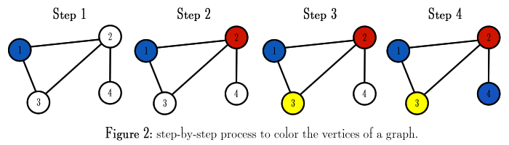
Coloring the Graph
No deep learning model yet
Can still color the interference graphs
Use as a dataset for training in the future
Notes:
Originally, we were planning on using some sort of deep learning model to learn from the output data generated by this, but that became an intractable goal. Regardless, there is much value in the data itself, and we still wanted to create a useful, labeled dataset that can be leveraged in the future to train a model, so we colored the output interference graphs using a standard greedy coloring implementation. We chose the greedy algorithm due to the fact that it tends to produce a result with fewer colors at the cost of execution speed and parallelizability. Because our focus is on creating a dataset, we care more about optimizing for the number of colors.

Slide 11
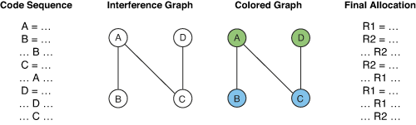
Colored Graph -> Register Allocation
Colors are independent sets of vertices
Independent sets on an IG can be claimed by a single register
Notes:
When an interference graph is finished being colored, it is a one to one process of assigning each variable to a register. The entire point of coloring the graph is to create sets of vertices that are independent, not connected by an edge. Because an edge represents interference between two nodes, all variables that are colored the same do not interfere with each other. This means that a single register can be used for all of the assignments made for each of these variables throughout the entire live of the program. In turn, the minimum number of registers required by a given interference graph is equal to its chromatic number. The translation from a colored interference graph to a register allocated program is simply mapping any instance of a virtual register to its color given by the graph.

Slide 12
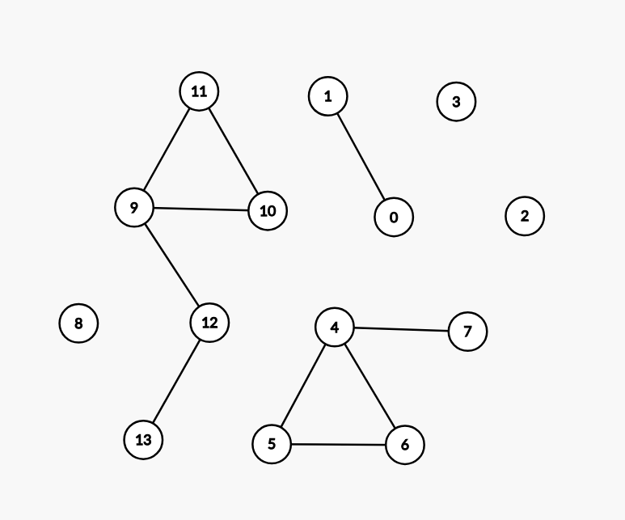
Multiple Functions
Each function contains an independent set of virtual registers
Registers local to functions at equal scope level cannot interfere with one another
Interference Graph of multiple functions =
U(Interference Graph of function k)
Notes:
Having colored the interference graph, we realize that this is a bit of a trivial outcome. No program consists of only a single function, much less a single function that is never called nor calls functions within. Tackling the first problem, it is actually remarkably simple to extend what has been discussed to a program containing multiple functions, due to the scoping rules of the C language. (ANIMATE) Functions implementations themselves are treated as independent execution units, meaning they are agnostic of the context in which they are called, outside of the variables passed into them via registers contained in the calling convention utilized, more on that soon. As a result, the output assembly code of multiple function implementations will contain usages of virtual registers that are entirely independent from one another. This makes sense intuitively, as a function is never interrupted in a serial program, meaning any registers it needs will be freed by the time the function returns. In turn, interference graphs of multiple functions are remarkably simple to construct, as they are just the independent union of all interference subgraphs of each function.

Slide 13
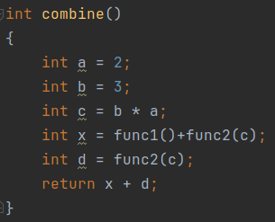
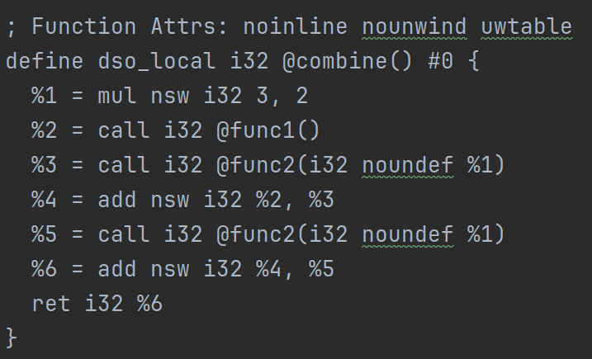
Function Calls
Function calls make things tricky due to calling conventions, sticking with x86 cdecl
EAX, ECX, EDX saved on caller’s stackframe
Rest need to be saved by callee if needed
Simplest solution: All variables live across function call interfere with every single variable within the function
Supernodes of the function’s subgraph
Notes:
Things get a bit more complicated when we actually call the functions themselves. There is no standard convention for how function calls should be made in assembly, so it is entirely up to the architecture of the hardware to determine what information, such as arguments and return value, needs to be written to memory or to registers in order to allow for the independent execution of a function. This is why the compiler ecosystem tends to be so diverse, as x86, ARM, IBM POWER, and all other ISAs each define their own convention. Either way, we are focusing on the x86-64 c declaration convention, as that is the architecture we all have on our computers. The simplest solution that makes the most sense intuitively is to consider every variable that stays live across the function call to interfere with every variable within the function. Save for argument and return registers, this is also representative of the most realistic solution, as all other registers are nonvolatile across calls, meaning they must be preserved by the callee. This can be done in one of two ways, by not overwriting them at all, or by saving the value to the stack and restoring it upon the return of the function. These are exactly the same semantics of a memory spill, which means that modeling the live registers as supernodes of the function’s subgraph works quite nicely.

Slide 14
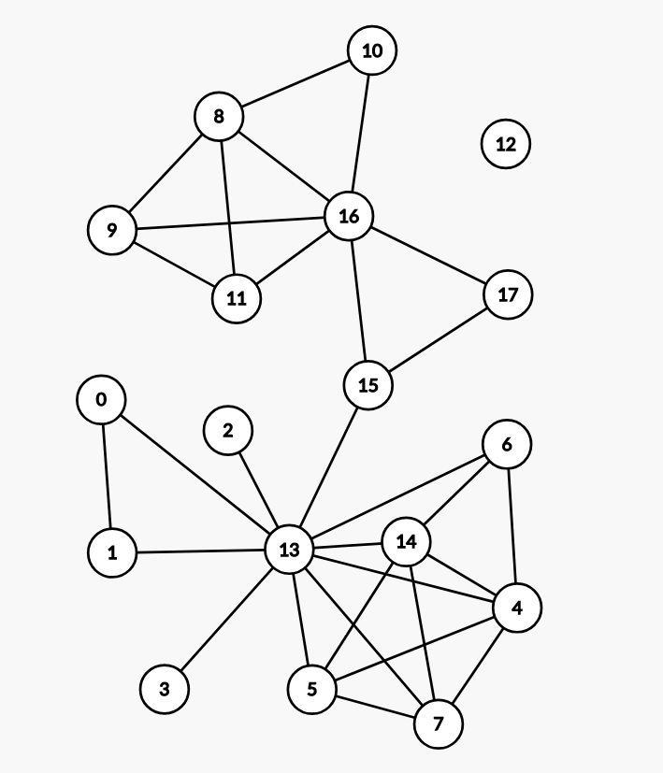
Function Calls - Cont.
Notes:
However, when actually constructing the final interference graph of an executable, the interference subgraphs are treated as abstract building blocks. This is due to the fact that a function can be called multiple times in different contexts, or even not called at all, in which case it should not be considered. The result of this is many copies of the same graph structure, as you can see here in this example. Func2 is called twice, meaning nodes 4 to 7 as well as 8 to 11 represent the same subgraph, only varying in which nodes of its caller, being 12-17, are supernodes. A result of this type of graph structure is that the supernodes of a parent function are inherited by any child functions it calls, as in, a value allocated to a register needs to persist in the same register until any children, grandchildren, etc functions have all returned.

Slide 15
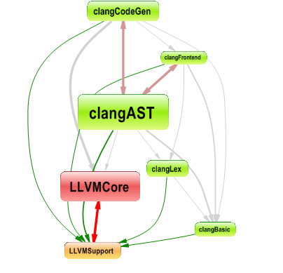
Multiple Files
Dependency chains can be complex
In theory, this should function the same
In practice, there is more to consider
Linked code from #includes
LLVM has a separate linker, we have not explored that far
Statically linked code is inside the executable
Dynamically linked code is not
Despite this, as long as call semantics are identical, the problem structure is the same
Notes:
There is a lot of introduced complexity when dealing with C includes and library linkage, none of which we have looked into yet. This is because, in theory, the interference graph generation process of multiple files should behave exactly the same as it does for a single compilation unit, as long as the compiler’s view of each file is consistent with the final linked program. However, in practice this assumption breaks down very quickly. When we introduce #include chains, we are effectively pulling in additional declarations, inline definitions, and sometimes entire subsystems of code that the compiler treats as if they were part of the current translation unit. This means the live ranges of variables, and even which variables exist at all, may be influenced by header structure rather than the source file we think we are analyzing. Beyond that, LLVM introduces another layer of complication with its dedicated linker. We have not explored that subsystem yet, but it fundamentally changes when and how global symbols are resolved. Statically linked code ends up physically inside the final executable, and therefore participates in the same optimization and analysis pipeline. Dynamically linked code, on the other hand, is not present during compilation, so any analysis that depends on complete visibility — including interference graph construction — cannot directly account for it. Despite all of these complications, the key point is that as long as the call semantics between files remain stable, the underlying structure of the problem does not actually change. The interference graph is still built from local variable lifetimes within each function. What becomes more nuanced is controlling where those functions come from and ensuring the compiler has enough information to treat them consistently.

Slide 16
Comparison to Prior Work
Found 2 datasets to train on -> both unsuitable
DIMACS / COLOR Graph Datasets
Not interference graphs
IEEE
Linear scan of the output IR file rather than actually examining the code dependency structure
Very simplistic liveliness algo
live range = [first_line_mentioned, last_line_mentioned]
Our work seeks to alleviate both of these shortcomings
As far as we know, this work is new and novel
Notes:
• “We initially found two public datasets for training: the DIMACS/COLOR graph datasets and an IEEE register-interference dataset. But both turned out to be unusable for our goals.”
• “DIMACS graphs aren’t interference graphs at all—they’re random or adversarial graph-coloring benchmarks. They have the wrong structure, wrong chromatic profile, and no program semantics. Training on them would teach the model patterns that simply don’t exist in real compiler workloads.”
• “The IEEE dataset is register-related, but their graphs are generated by doing a linear scan over the IR instead of analyzing true code dependencies. They treat liveness as ‘first line mentioned to last line mentioned,’ which is extremely naïve and doesn’t resemble real interference-graph construction.”
• “They also don’t run a real interference analysis, no live-range splitting, no actual liveness propagation through control flow. So the graphs are structurally wrong for register allocation.”
• “Our work directly fixes both problems. We generate interference graphs by running the full LLVM pipeline, plus our custom passes, on actual C code. So our graphs reflect real liveness, real control flow, and real register pressure.”
• “To the best of our knowledge, no one has built a large-scale, compiler-accurate interference-graph dataset for ML-based colorings before. This makes our dataset, and the learning approach on top of it, genuinely new.”

Slide 17
Dataset
Poor datasets -> need to pivot
We bit off more than we can chew
Will focus on the “top” part of our previous chart
New objective -> produce a dataset better than what we found for use by researchers later
Notes:
• “After exploring the available datasets, we realized the existing options were too poor in quality to support our original goals. So we had to pivot.”
• “In hindsight, we bit off more than we could chew by trying to jump straight into training a neural model on top of datasets that weren’t even suitable to begin with.”
• “So we decided to focus on the top part of our original pipeline—the data generation phase—rather than the machine-learning phase.”
• “Our new objective is simple but important: build a high-quality interference-graph dataset that is better than anything currently available, so that future researchers won’t face the same limitations we did.”
• “The diagram shows our workflow: we take real C and C++ programs, feed them into our custom interference-graph generator, and produce a clean, compiler-accurate interference graph dataset.”

Slide 18
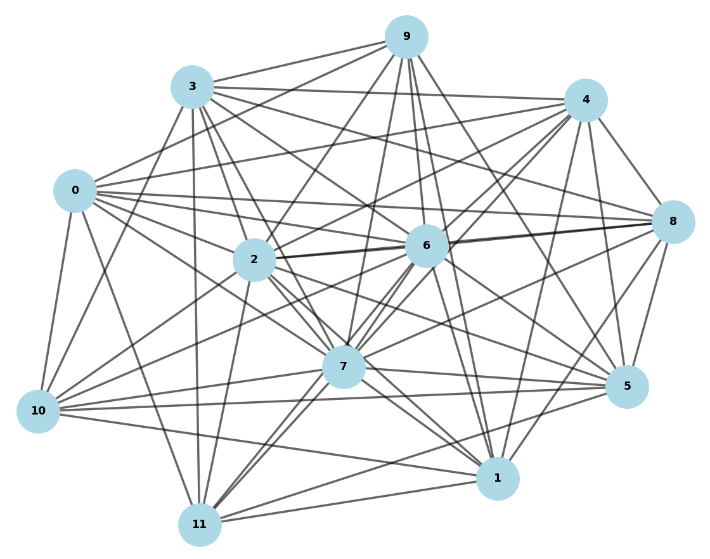
Prelim Results
Notes:
Right now we need to continue debugging and adding features to our current code to truly produce something new however there are the current fruits of our labor
This graph is the result of the full pipeline at work. We were able to take the C code from slide 13, process that in LLVM, extract the registers and finally produce a full interference graph via a python script we made. This, plus the edge list this came from, is the final product of our data set.
We also need to finish an automation script. Currently we go through each step manually. The final goal is to go from C source code to a graph you see here after one command

Slide 19
Future Work
Current goals:
Debug and test current code
Finish automation script
Stretch goals:
Create a NN model and use the dataset generated to train it
Generate canonical interference subgraph colorings for library functions for efficient coloring
Examine calling convention semantics, special cases for volatile registers
Notes:
Of course, the first step in continuing this project is to reexamine our original goal of creating a NN model to learn features from interference graphs to color them efficiently and optimally. We will still “In the short term, our focus is very practical: we need to finish debugging the generator and make sure the pipeline is fully reliable.”
• “We’re also finishing the automation script so we can run large batches of programs without manual intervention. This is key for scaling the dataset.”
• “If time allows, our main stretch goal is to return to the original vision—training a neural network on the dataset we generate. Now that we understand the data limitations, this would be far more meaningful.”
• “Another potential direction is generating canonical subgraph colorings for commonly used library functions. These appear frequently in real codebases and could improve downstream register allocation.”
• “Finally, there’s more nuance we could explore around calling conventions and volatile registers. These introduce edge-case constraints that real compilers must handle, so modeling them would deepen the dataset’s realism.”

Slide 20
Thank You
Any Questions

